Slide 1
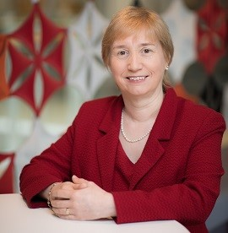

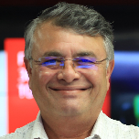
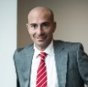


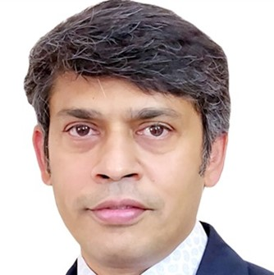





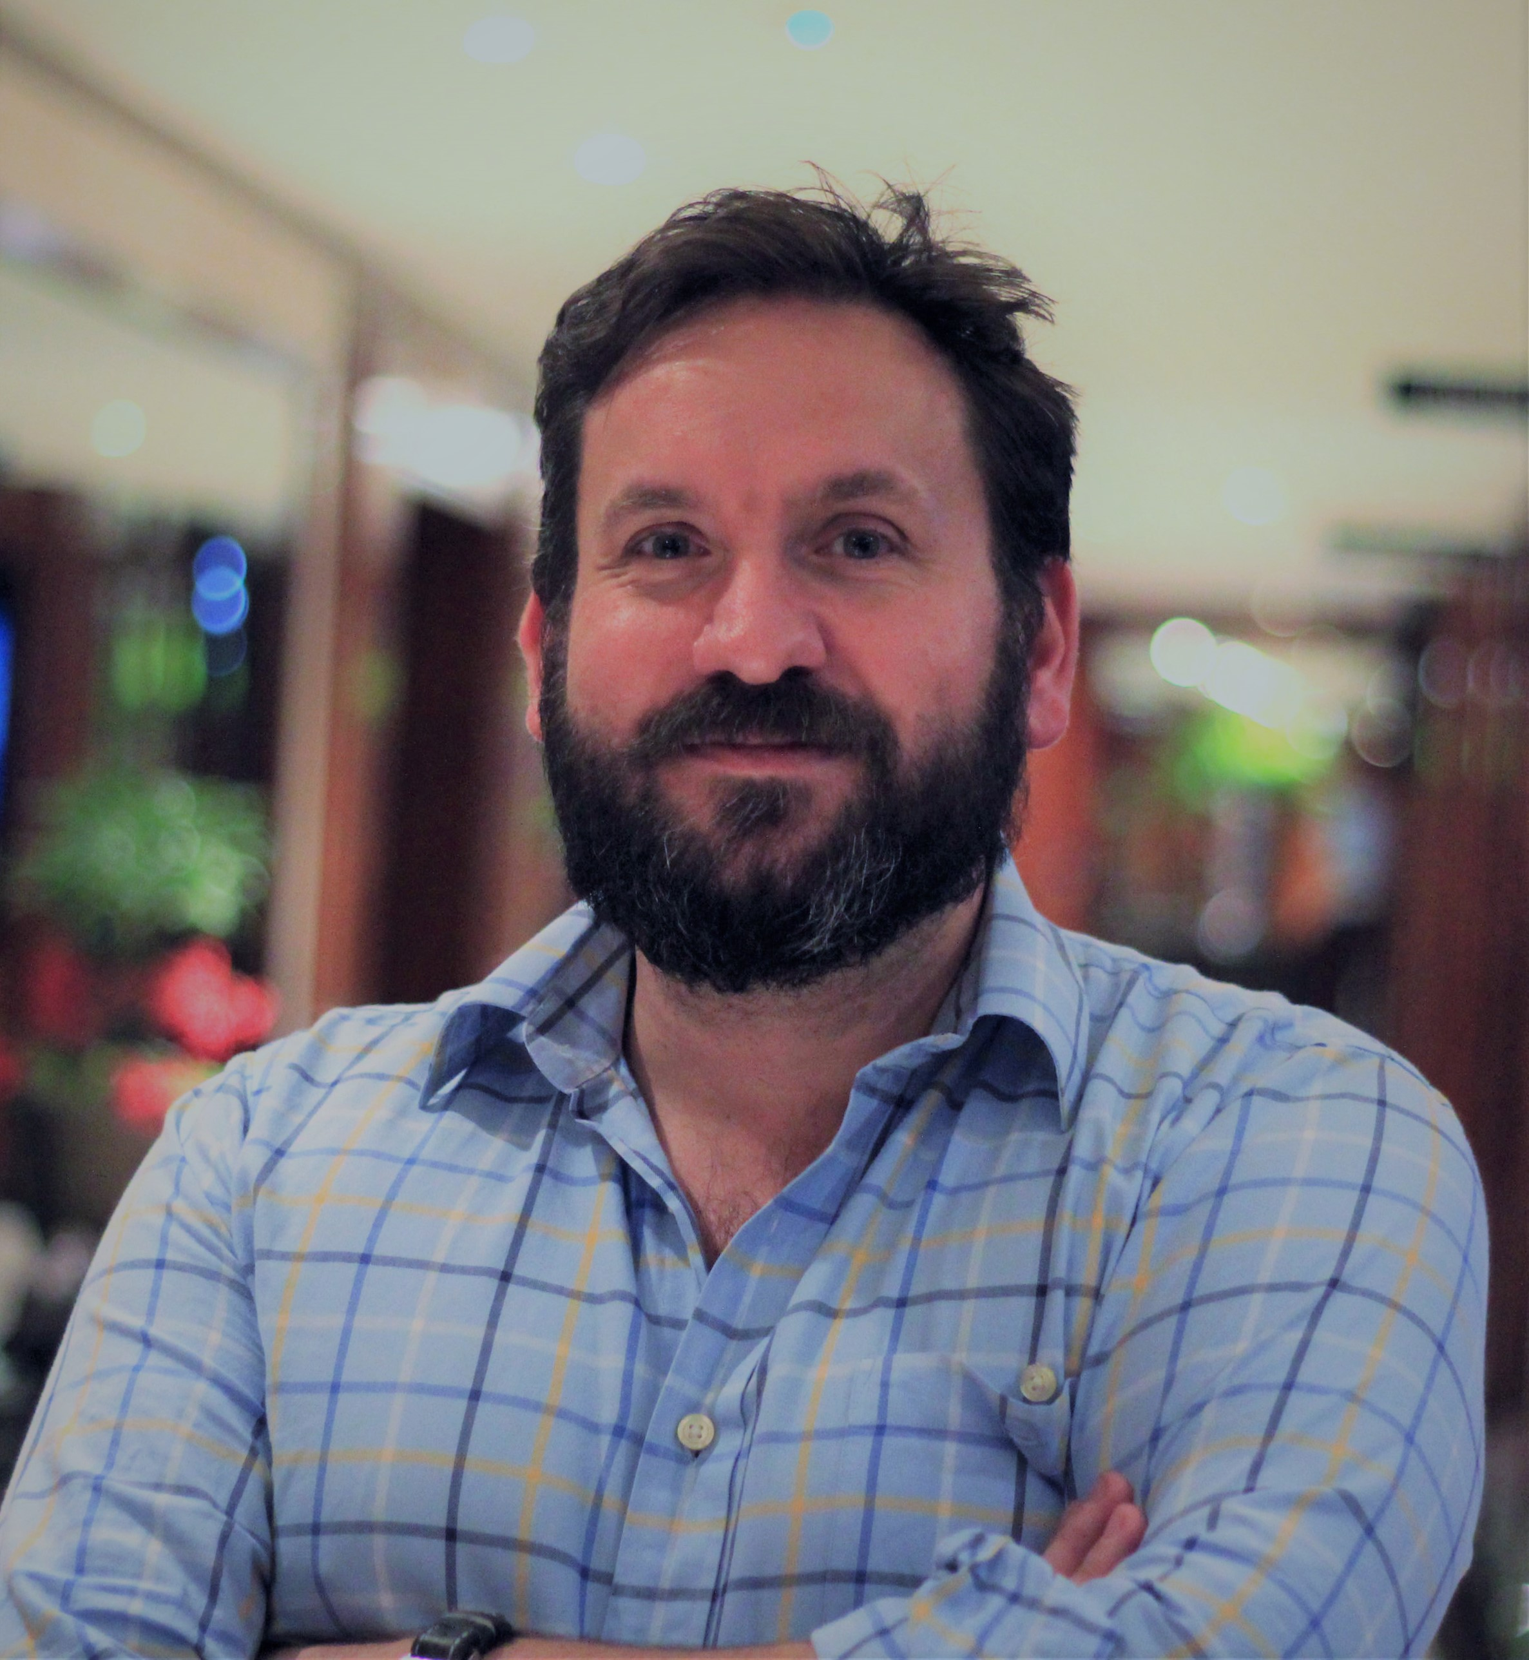


Global Delivery Organization
Head: Regina Moran
Executive Support: Sophie Brill
GSBG Shared Functions
Asia Cluster
Europe Cluster
NWE Delivery
Americas Delivery
Global Pre-Sales
& Solutions (GPS)
HR
Head: John Lucas
Head: Shrikant Vaze
Head: Luis Matias
Head: Jean-Marc Chammas
Head: Asif Poonja
Head: Gopalakrishnan Krishnamurthi (GK)
Finance
Head: Jaswinder Sohal
Asia Cluster GDCs
Europe Cluster GDCs
Regional Service Delivery
Delivery Excellence
Bid & Proposal management
Marketing
JGG Delivery Unit
Poland
CTO, Consulting & Prof Services
Project Mgt & Tools
Solution Architecture & LDA
Head: Alex McAdam
India
Portugal
Service Integration
Solution Governance
Offer pre-sales support
Responsible Business
China
Russia
Service Management
Managed Services (W&WS, ECS)
Cost Model and Service Components
Head: Sarah-Jane Littleford
Philippines
Asia GDC Teams
Program & Project Services
Application Services
Benchmarking
Business Ops. and
Japan Engagement
Malaysia
Application & Multi-Cloud Services
Partner Business Solutions (incl. DX)
Business development support
Costa Rica
Workforce & Workspace Services
Partner Alliances
Collateral & Enhancement Services
Partner Business Solutions
Head: Nozomu Murakami
DX Services
Strategic Programs
and Change
Enterprise Cyber Security Services
Head: Regina Moran
Territory Management
GD Corporate Functions
Western Europe
CISO
Finland
Scandinavia
Accounts & Services
Head: Clive Tillotson
Ireland
CIO
UK Private Sector
Head: Phil Wigglesworth
UK Public Sector
Service Delivery
Quality & Excellence
Region Heads
CEE Delivery
Asia Delivery
Oceania Delivery
Japan Delivery
Head: Benoit Panier

